Slide 1
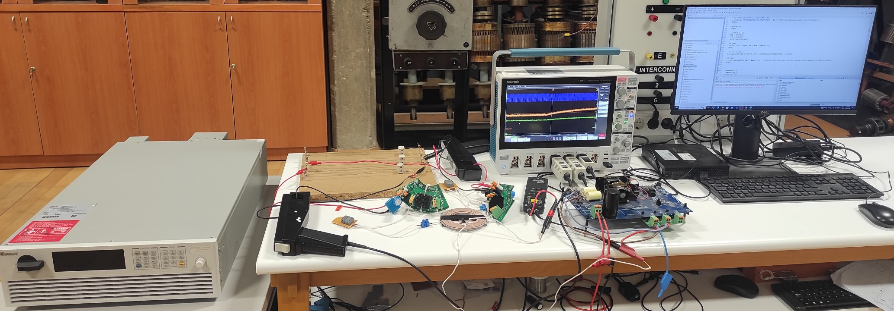
Oscilloscope
Current Probes
Voltage Source
Loads
Voltage Probe
PC
Rectifiers
Resonant Capacitors
WPT coils
Full-bridge Inverter

Slide 2
Oscilloscope
Current Probes
Voltage Source
Loads
Voltage Probe
PC
Rectifiers
Resonant Capacitors
WPT coils
Full-bridge Inverter

Slide 3
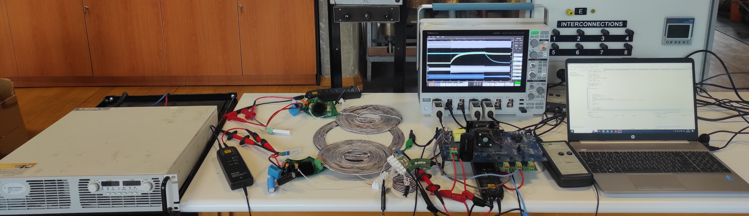
Rectifiers
Resonant Capacitors
Current Probes
Oscilloscope
FB Inverter
Voltage Source
Voltage Probes
Loads
Dual-frequency
Compensation
PC
WPT coils

